Slide 2
Inheritance
polymorphisam
Virtual function
Pure virtual function
Friend function

Slide 3
Polymorphism
Polymorphism means "many forms", and it occurs when we have many classes that are related to each other by inheritance
we can define polymorphism as the ability of a message to be displayed in more than one form.

Slide 4
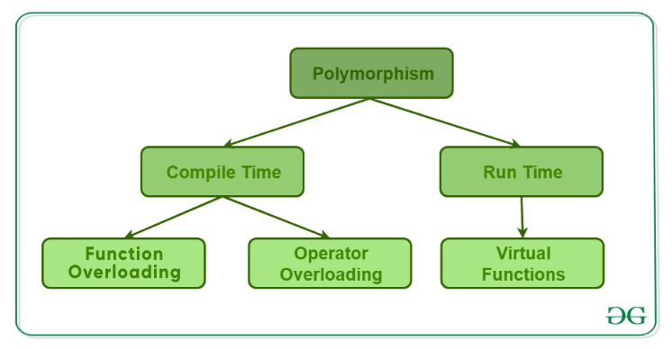
Types of Polymorphism
Types of Polymorphism
Compile-time Polymorphism.
Runtime Polymorphism.

Slide 5
Early binding vs late binding
Early Binding (compile-time time polymorphism) As the name indicates, compiler (or linker) directly associate an address to the function call. It replaces the call with a machine language instruction that tells the mainframe to leap to the address of the function.
Late Binding : (Run time polymorphism) In this, the compiler adds code that identifies the kind of object at runtime then matches the call with the right function definition . This can be achieved by declaring a virtual function.

Slide 6
Virtual Function
A virtual function is a member function that is declared in the base class using the keyword virtual and is re-defined (Overridden) in the derived class.
Some Key Points About Virtual Functions:
Virtual functions are Dynamic in nature.
They are defined by inserting the keyword “virtual” inside a base class and are always declared with a base class and overridden in a child class
A virtual function is called during Runtime

Slide 7
Rules of Virtual Function in C++
The functions cannot be static
You derive them using the “virtual” keyword
Virtual functions in C++ needs to be a member of some other class (base class)
They can be a friend function of another class
The prototype of these functions should be the same for both the base and derived class
Virtual functions are accessible using object pointers
Redefining the virtual function in the derived class is optional, but it needs to be defined in the base class
The function call resolving is done at run-time
You can create a virtual destructor but not a constructor

Slide 8
class Base{
public: void show() { cout<<" In Base \n"; }
};
class Derived: public Base{
public: void show() { cout<<"In Derived \n"; }
};
int main(void){
Base *bp = new Derived;
bp->show();
return 0;
}

Slide 9
class Base{
public: virtual void show() { cout<<" In Base \n"; }
};
class Derived: public Base{
public: void show() { cout<<"In Derived \n"; }
};
int main(void){
Base *bp = new Derived;
bp->show();
return 0;
}

Slide 10
Pure Virtual Functions and Abstract Classes in C++
A pure virtual function (or abstract function) in C++ is a virtual function for which we don’t have an implementation, we only declare it. A pure virtual function is declared by assigning 0 in the declaration.
When to use Pure virtual functions are used
if a function doesn't have any use in the base class
but the function must be implemented by all its derived classes.
Abstract class
A class that contains a pure virtual function is known as an abstract class.

Slide 11
Difference between Virtual function and Pure virtual function
A virtual function is a member function which is declared within a base class and is re-defined(Overridden) by a derived class. When you refer to a derived class object using a pointer or a reference to the base class, you can call a virtual function for that object and execute the derived class’s version of the function.
virtual<func_type><func_name>(){ }
A pure virtual function (or abstract function) in C++ is a virtual function for which we don’t have an implementation, we only declare it. A pure virtual function is declared by assigning 0 in the declaration.
virtual<func_type><func_name>() = 0;

Slide 12
Abstract class
An abstract class is a class in C++ which have at least one pure virtual function.
Abstract class can have normal functions and variables along with a pure virtual function.
Abstract class cannot be instantiated, but pointers and references of Abstract class type can be created.
Abstract classes are mainly used for Upcasting, so that its derived classes can use its interface.
If an Abstract Class has derived class, they must implement all pure virtual functions, or else they will become Abstract too.
We can’t create object of abstract class.

Slide 13
Working of virtual functions (concept of VTABLE and VPTR)
if a class contains a virtual function then compiler itself does two things.
If object of that class is created then a virtual pointer (VPTR) is inserted as a data member of the class to point to VTABLE of that class. For each new object created, a new virtual pointer is inserted as a data member of that class.
Irrespective of object is created or not, class contains as a member a static array of function pointers called VTABLE. Cells of this table store the address of each virtual function contained in that class.

Slide 14
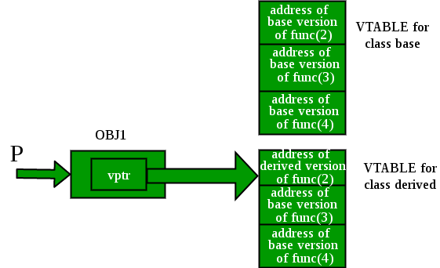

Slide 15
Friend Function
a friend function can be given a special grant to access private and protected members. A friend function can be:
a) A member of another class b) A global function
A friend function is a special function in C++ which in-spite of not being member function of a class has privilege to access private and protected data of a class.
A friend function is a non member function or ordinary function of a class, which is declared as a friend using the keyword “friend” inside the class. By declaring a function as a friend, all the access permissions are given to the function.
The keyword “friend” is placed only in the function declaration of the friend function and not in the function definition.
When friend function is called neither name of object nor dot operator is used. However it may accept the object as argument whose value it want to access.
Friend function can be declared in any section of the class i.e. public or private or protected.

Slide 16
Friend Function
class <class_name>
{
friend <return_type> <function_name>(argument/s);
};

Slide 17
Friend Function advantages and disadvantage
Merits:-
A friend function is able to access members without the need of inheriting the class.
Friend function acts as a bridge between two classes by accessing their private data.
It can be used to increase the versatility of overloaded operator.
It can be declared either in the public or private or protected part of class.
Demerits:-
Friend functions have access to private members of a class from outside the class which violates the law of the data hiding.
Friend functions cannot do any run time polymorphism in its members.

Slide 18
Forward Declaration
Forward Declaration refers to the beforehand declaration of the syntax or signature of an identifier, variable, function, class, etc. prior to its usage (done later in the program).
In C++, Forward declarations are usually used for Classes. In this, the class is pre-defined before its use so that it can be called and used by other classes that are defined before this.
// Forward Declaration class A
class A;
// Definition of class A
class A{
// Body
};

Slide 19
Operator overloading

Slide 20
What is operator overloading?
It’s a type of polymorphism in which an operator is overloaded to give it the user-defined meaning.
Changing the definition of an operator so it can be applied on the objects of a class is called operator overloading.
To overload an operator, we need to write a function for the operator we are overloading.

Slide 21
syntax
returnType operator operatorSymbol (formal parameter list)

Slide 22
Overloading an Operator: Some Restrictions
1. You cannot change the precedence of an operator.
2. The associativity cannot be changed. (For example, the associativity of the arithmetic operator addition is from left to right, and it cannot be changed.)
3. Default parameters cannot be used with an overloaded operator.
4. You cannot change the number of parameters an operator takes.
5. You cannot create new operators. Only existing operators can be overloaded.
6. The operators that cannot be overloaded are: . .* :: ?: sizeof
7. The meaning of how an operator works with built-in types, such as int, remains the same.
8. Operators can be overloaded either for objects of the user-defined types, or for a combination of objects of the user-defined type and objects of the built-in type.

Slide 23
8.3 Restrictions on Operator Overloading

Slide 24
rules for operator overloading in C++?
To work, at least one of the operands must be a user-defined class object.
We can only overload the existing operators, Can’t overload new operators.

Slide 25
